Slide 1
Capstone Project
Select location for restaurant in the city of San Antonio

Slide 2
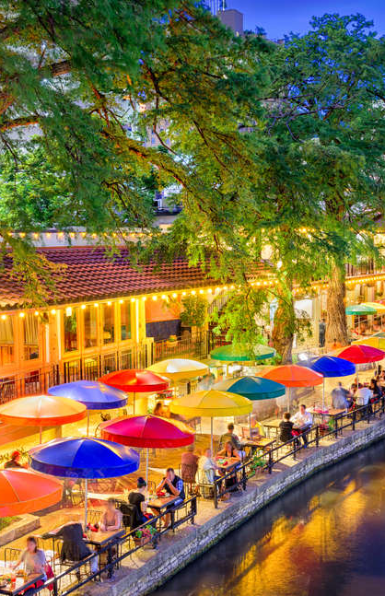
Goals
Open a new restaurant in the city of San Antonio
Avoid the area with too many restaurants
The areas with plenty residents and commercial facilities

Slide 3
Data
Web scaping
coordinate of San Antonio counties zip code:
http://sanantonio.areaconnect.com/zip2.htm?city=San%20Antonio&qs=TX&searchtype=bycity
population of San Antonio counties:
http://zipatlas.com/us/tx/san-antonio/zip-code-comparison/population-density.htm
Foursquare API

Slide 4
Methodology
Data visualization
DBSCAN clustering
Multiple regression

Slide 5
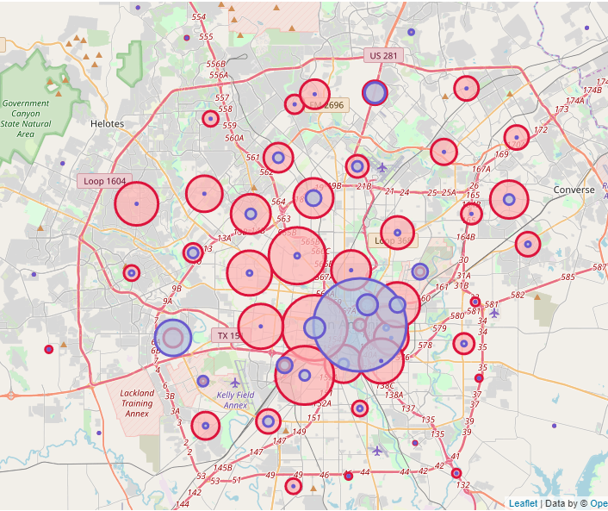
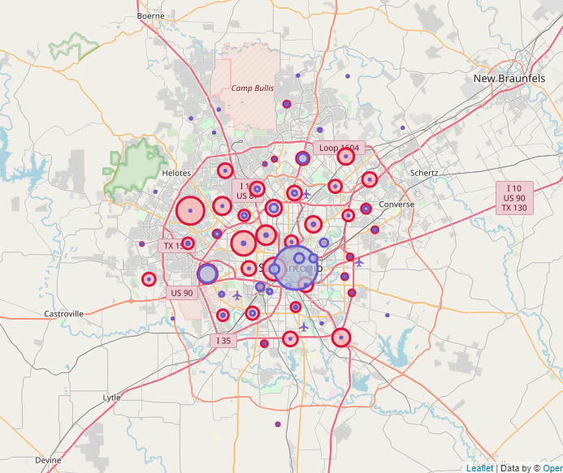
Population & Density
78205 has most of the restaurants. Riverwalk is the famous tourist attraction in San Antonio and it is located in 78205 and 78215 so the restaurants are very crowded there.
78227 and 78232 also have many restaurants. 78227 is along the Loop 410 and 78232 is in stone oak.

Slide 6
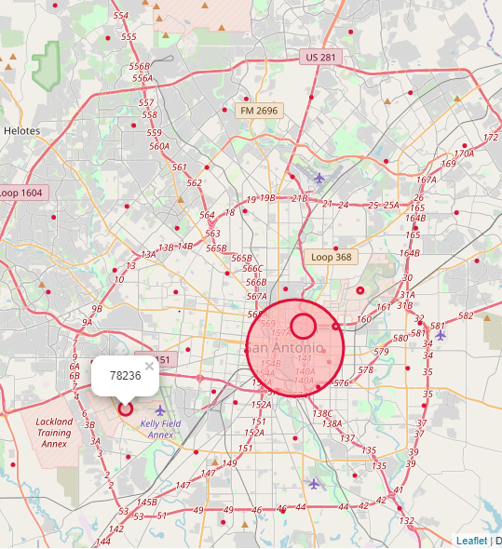
Number of restaurants vs Population
We calculated the ratio of restaurant number and population, and sorted the ratio values so that we can avoid the areas that are already crowded with existing restaurants.
We will use 0.0001 as a cutoff value for ratio, so we would exclude zip code 78205, 78215, 78236, 78208, 78234, 78226, 78204, 78227, 78225, 78232, 78259.

Slide 7
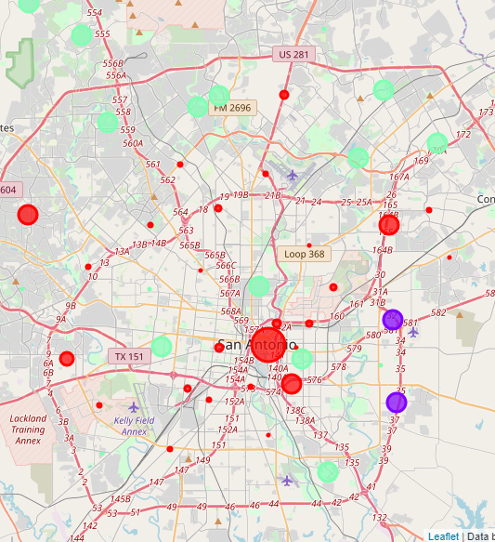
DBSCAN clustering
Our dataset was clustered into 3 categories:
Areas with moderate population but not so many commercial facilities
Areas with most residents and commercial facilities
Areas with low in population and density

Slide 8
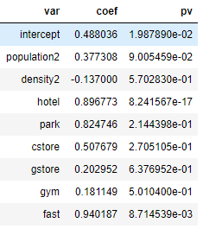

Linear regression
$Restaurant=0.488+0.377Population−0.137Density+0.897Hotel+0.825Park+0.508ConvenientStore+0.203GroceryStore+0.181Gym+0.94FastFood$

Slide 9
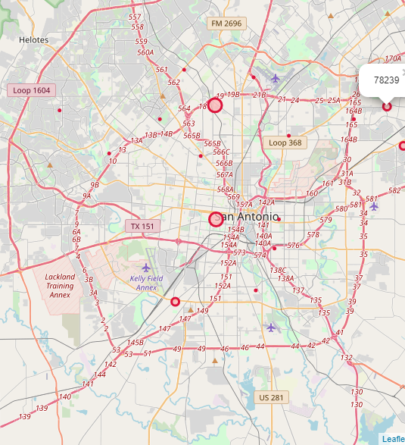
Final recommendation
78207 and 78213 would be the ideal place to open a new restaurant.
78211, 78244, 78239 would be our second recommendation.

Slide 10
Conclusion & Discussion
Type of restaurant
School rating
House price
Rental price
Customer review

